Slide 1

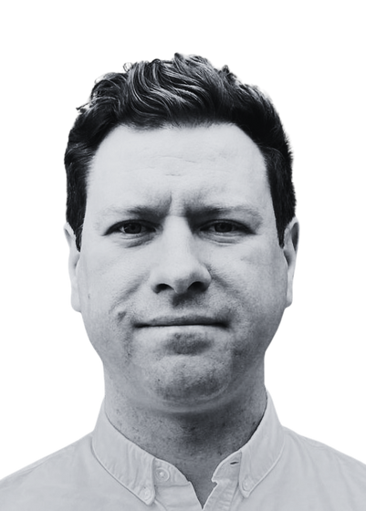


What is the healthcare exceptionalism objection to environmentally sustainable healthcare and how should we respond to it?
Wednesday, May 14, 2025
12:00-1:30 pm EST
Dr. John B. Appleby, Lancaster Medical School, Director of PhD, Medical Ethics and Law, Lancaster University

Slide 2











Collaborative Centre
New academic unit @ UofT
  Connecting hub & catalyst
  Newly launched Strategic Plan: 2023-2028
  Partnership of 4 health science faculties
Our Purpose
To catalyze climate & sustainability action for health & health systems through research, education, and practice & policy change.
Our Strategic Priorities
Sign up for our newsletter to receive updates on
  Climate & Health Seminar Series
  Community & research news
  Other updates & opportunities
Research
Shape the future
of climate, environment & sustainability research in the health sciences.
Education
Equip learners to understand and act on the health and health system challenges of climate & environmental change.
Policy &
Practice Change
Activate practice
& policy change to promote health & health system sustainability.
2
climatehealth.utoronto.ca

Slide 3




What is the healthcare exceptionalism objection to environmentally sustainable healthcare and how should we respond to it?
Dr John Appleby
Lecturer in Medical Ethics
Lancaster University

Slide 4
Overview
Background
Part 1: What is the healthcare exceptionalism objection?
Part 2: How should we respond to the healthcare exceptionalism objection?
Summary and next steps…

Slide 5

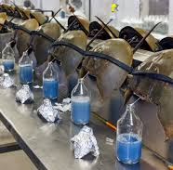
Background
Healthcare is one of the most environmentally destructive industries on earth
  This environmental destruction can be generalised into at least 3 categories:
    gaseous waste (e.g. greenhouse gases),
    solid waste (e.g. plastics, etc.),
    chemical/pharmaceutical waste (nuclear at least fits across the last two)
For example, healthcare’s climate footprint is about 4.4% of global net emissions
For solid waste and chemical/pharmaceutical waste we have incredibly weak data, but in the UK alone estimates from the NHS are at 156 000 tonnes of clinical waste per year.
The cost of healthcare can also be measured in how we consume living and non-living resources that are part of ecosystems.

Slide 6
Background
Efforts are now being made to make healthcare more environmentally sustainable
For example: NHS plans for ‘net zero for direct carbon emissions by 2040, and net zero for indirect carbon emissions by 2045’ (https://www.england.nhs.uk/long-read/nhs-clinical-waste-strategy/?form=MG0AV3)
‘Greener NHS’ arm of NHS set up to lead this programme of change
General Medical Council (medical regulator in UK) now requires medical education programmes to integrate teaching about sustainable healthcare and to teach students how to engage with their future patients about the environmental sustainability of their healthcare.
Environmentally sustainable medicine is an emerging global concern, and medical societies, governments and regulators around the world are also taking action in this area

Slide 7

Background
Therefore, many agree that action needs to be taken to make healthcare more sustainable
This action needs to be taken on at least three levels:
  Industrial (e.g. the policy of training for doctors nationwide, the manufacturing of goods, developing industry wide sustainability standards, etc.)
  Institutional (e.g. decisions being made at hospitals and hospital networks)
  Individual level (e.g. healthcare service providers and patients)

Slide 8
Background
    Policies are already being put in place to try to limit the use or capture anaesthetic nitrous oxide that leaks into the atmosphere during treatment
    Currently in the England, some large scale decisions are being made in a top-down (industrial and institutional level) approach to create change – e.g. encouraging ‘green inhalers’
    However, almost all responsibility for change to meet sustainability targets is being placed on regional Integrated Care Systems (responsible for planning and delivering services locally) and individual local clinics.
    Why? The English regional Integrated Care Systems and county wide care systems generally operate in data silos which are not shared centrally. Without centralised data and control over local budgets, it is challenging for the NHS to make informed policies choices from the top down on how to responsibly administer sustainable healthcare.
    Result: A lot of decisions are happening at the clinic or doctor-patient level – not just at the top level

Slide 9
Background
But what is healthcare?
I use the word to broadly refer to the entire system of creating, providing and consuming healthcare goods and services.
For example, this includes everything from researching a vaccine, to manufacturing it, to jabbing it in a patient’s arm, and then subsequently throwing it away so that it can later be incinerated, landfilled, or illegally dumped.
‘Healthcare’ refers to the industries, institutions and individuals that take part in it (including patients). It includes the buildings, vehicles and physical materials required to make healthcare work.
This is a broad definition, but it is necessary in order to account for the extent to which healthcare draws on all types of resources and activities across our society.
What is environmental sustainability?
Sustaining an environmental state.
E.g. meeting sustainability goals, such as reaching net zero and sustaining that, or, not extinguishing vulnerable species and their ecosystems, etc.

Slide 10
Background
How should sustainable healthcare decisions be made in an ethical way?
One option is to follow a principle I have developed called ‘the principle of environmental beneficence’
  It states: when healthcare decisions are being made, priority should be given to whatever course of action would bring about the most environmentally sustainable outcome while also sufficiently meeting the health needs and respecting the important life projects of the patient(s). This allows for decision-making to be adapted so that in instances where a healthcare decision involves a trade-off between maximising environmental sustainability and patient needs, there is scope to make different decisions based on the varying needs of different patients and their own notions of a good life.

Slide 11
Background
  However, an objection has emerged in everyday discussions and the literature:
  Do not burden healthcare at any level with concerns about environmental sustainability. Healthcare is special and an exception to any rule, policy or attitude about environmental sustainability.
  What are we to make of this objection?

Slide 12
Part 1: What is the healthcare exceptionalism objection?
  I refer to this objection as the ‘healthcare exceptionalism objection’.
  The objection is structured as follows:
  Healthcare is important to promote human welfare and flourishing
  Environmental sustainability interventions in healthcare may threaten healthcare’s ability to be delivered in a way that allows potential benefits (broadly construed) to be realised to a desired extent
  Therefore, society should treat healthcare as exceptional and either avoid or minimise any burdens placed on it for the purposes of achieving environmental sustainability

Slide 13
Exceptionalism and healthcare
Exceptionalism as meaning ‘different from the norm’
Hippocrates recognised this and created Hippocratic oath
Sir William Osler, felt that medicine was exceptional because as a profession and body of knowledge, it represented an exceptional achievement for humanity. He stated that ‘[i]n a little more than a century a united profession, working in many lands, has done more for the race than has ever before been accomplished by any other body of men’ [sic] (Osler, 1905: 335). ‘Man’s redemption of man’ (Osler, 1910: 357)
Roy Porter book – ‘The Greatest Benefit to Mankind’ (1999)
Other examples: research exceptionalism, genetic exceptionalism, HIV exceptionalism, psychedelic exceptionalism, biospecimen exceptionalism, etc.

Slide 14
Exceptionalism and healthcare
Exceptionalism in this debate: healthcare deserves to be treated in an exceptional way, but it is different from other pre-existing forms of exceptionalism, as it refers solely to debates about sustainable healthcare
Hard healthcare exceptionalism: hard healthcare exceptionalist position is one that would resist any interference from healthcare sustainability considerations in relation to any given aspect of healthcare. According to such a view, all resources and activities should be focused on healthcare, regardless of extreme consequences to the environment and the existential risk to humanity.
Soft healthcare exceptionalism: that environmental sustainability concerns should not intervene on the project of healthcare to the extent that it can no longer fulfil its function of delivering healthcare goods and services to society.

Slide 15
Part 2: How should we respond to the healthcare exceptionalism objection?
Research question: How much weight should we give to this objection when determining the burdens that should be placed on healthcare to be environmentally sustainable?
Thesis: I argue that healthcare should be treated as exceptional insofar as it should not be overburdened with the demands of sustainability to the point where it no longer delivers on the health needs of those it serves; however, this does not mean that healthcare should be treated as exempt from the urgent need to become more sustainable.
Therefore, healthcare should do everything necessary to reduce its impact on the environment while ensuring that these sustainability efforts are balanced against providing the healthcare goods needed for patients to lead a flourishing life.
This argument aligns with the ‘soft healthcare exceptionalist position’.

Slide 16
Industry level
Public or private industry that encompasses the industry training (e.g. medical education), governance and provision of healthcare professionals and healthcare goods (e.g. pharmaceuticals, personal protective equipment, software, or cloud servers).
It also encompasses the physical infrastructure used across the healthcare industry (e.g. hospital networks, clinics, factories).
Objection: attempts to improve sustainability may distract resources away from crucial industrial projects of biomedical innovation, the training and oversight of healthcare professionals, and the general project of resourcing safe, efficient and effective care.

Slide 17
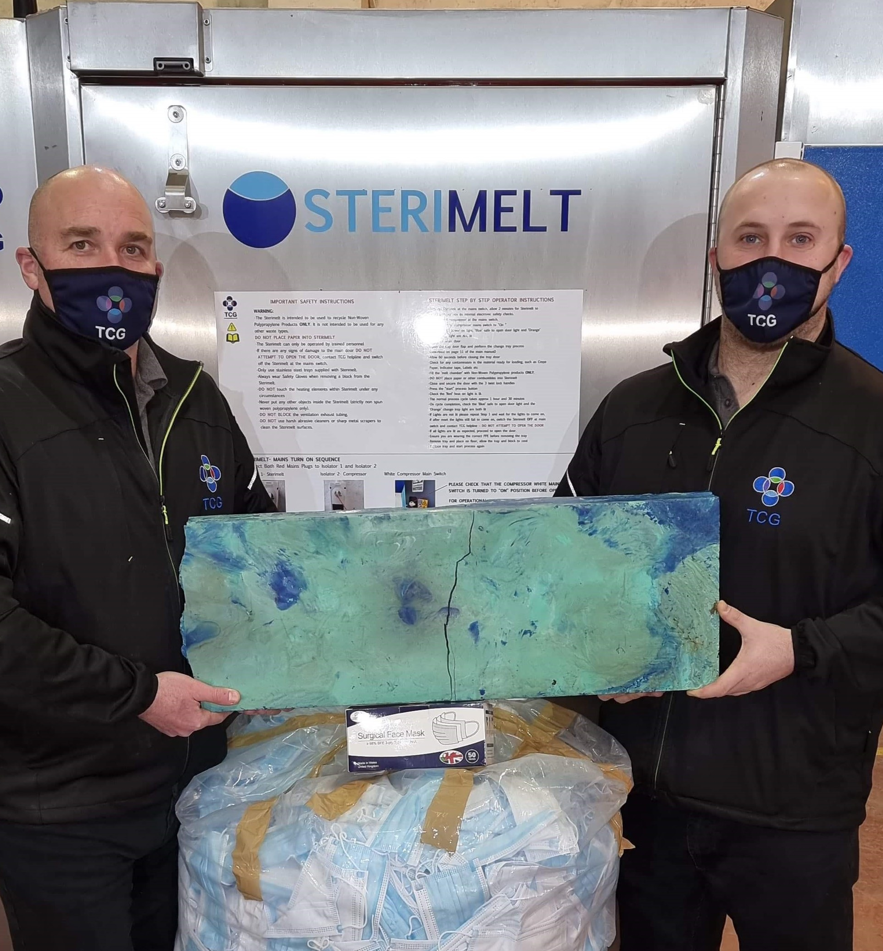
Industry level
Soft exceptionalist response:
These concerns are valid, but not sufficient to rule out interference
For example: Personal Protective Equipment recycling
Thermal Compaction Group (TCG) recycles PPE, and end product can be used to make new equipment

Slide 18
Institutional level
I am referring to hospitals, clinics, individual healthcare companies (e.g. pharmacies) or universities, among others.
Objections:
  Sustainability burdens could affect the financial viability or competitiveness of an institution.
    Government could subsidize and/or there is a change clinics could make without financial impact
  One size fits all solutions might not work for all institutions
    Work with regulators to ensure accommodations are made proportionally
  Not an urgent priority for the community being serviced
    Does not mean all change must be excluded, including change that does not necessarily impact priorities (e.g. recycling schemes)
  Some institutions are simply much less sustainable than others (e.g. blood donation clinics are high waste clinics)
    These types of clinics could still benefit from innovations that would reduce the volume of pollution and consumption caused

Slide 19
Healthcare service providers and patients
At the level of individual healthcare service providers and patients
Objections:
  Medicine is hard enough without having to worry about sustainability concerns
  Sustainability interventions will compromise the standard of care for patients (and put doctors at legal risk too)
  Patients could be discouraged from seeking care because of the burden or guilt of sustainability concerns
  Could compromise informed consent and unnecessarily burden the private doctor-patient interaction, and potentially the patient could lose trust in doctors

Slide 20
Summary and next steps
The Healthcare Exceptionalist Objection is real and increasingly emerges in the healthcare sustainability debate
Soft Healthcare Exceptionalism appears to be the best way to take seriously concerns about the impact of sustainability burdens on the provision of healthcare while accommodating sustainable interventions
There are nevertheless some other lingering objections/questions that need to be addressed (not exhaustive):
This is a very westernised view of healthcare, how does this fit with indigenous perspectives on health and the environment?
What is the goal of health?
There is the larger question of justice and whether any of these concerns are actually realistic priorities for countries or communities where there are not even resources for healthcare, let alone resources for sustainability interventions
What could a public health approach to medical sustainability offer this debate?

Slide 21

Thank you!
Dr John Appleby
Email: j.appleby@lancaster.ac.uk

Slide 22

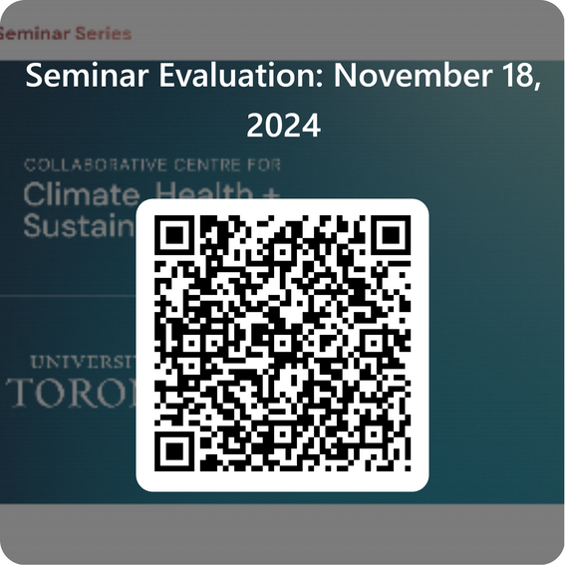
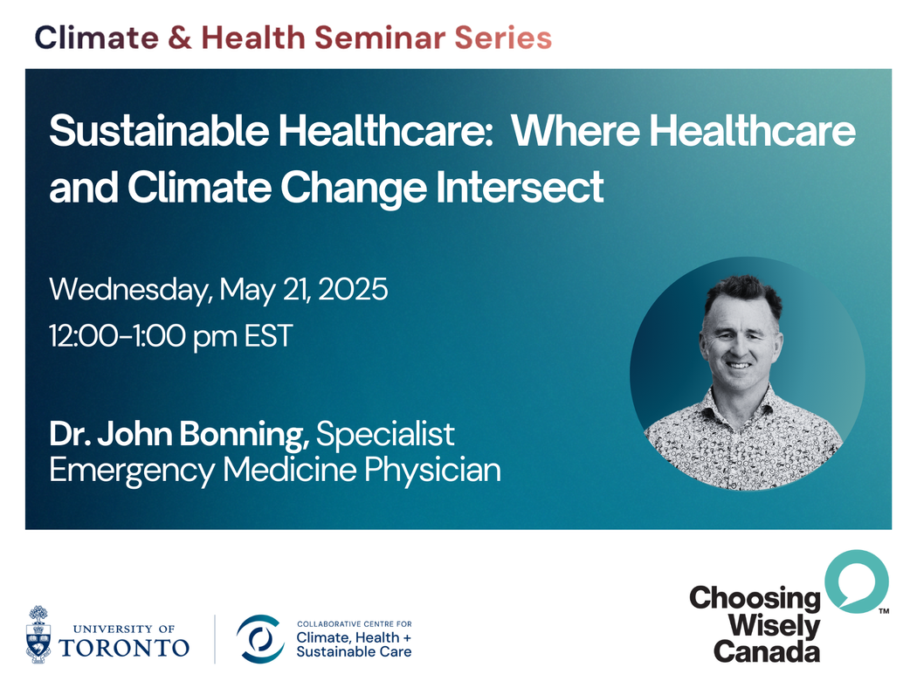

Next Climate & Health Seminar:
Please provide feedback
on today’s seminar
Sign up for our newsletter
to receive updates on
  Climate & Health Seminar Series
  Community & research news
  Other updates & opportunities
Get in touch
  linktr.ee/climate.health
  climate.health@utoronto.ca

